Slide 1
Railway Reservation
END TERM PROJECT
Submitted by:
Vishal Das: 11702786 [47]
Kishor Mitra: 11718947 [48]
Mirthipati Kesava Rao: 11702832 [34]
Gundeti Chinnesh: 11704296 [38]
Under the Guidance of: Dr. Gokulnath K

Slide 2
Contents
Aim
Technology Used
Modules
Responsible Person
Screenshots
Codes
Summary

Slide 3
Aim
The aim behind making this project is solely to make online Railway Booking more prevelent
This will help get rid of traditional booking i.e. Counter Booking
This is more secure and provides ease of booking and better maintanance of records over long time
Data analysis to lift Railway Services over time
Hassel free ticket booking

Slide 4
Technologies Used
HTML 5
CSS 3
Javascript

Slide 5
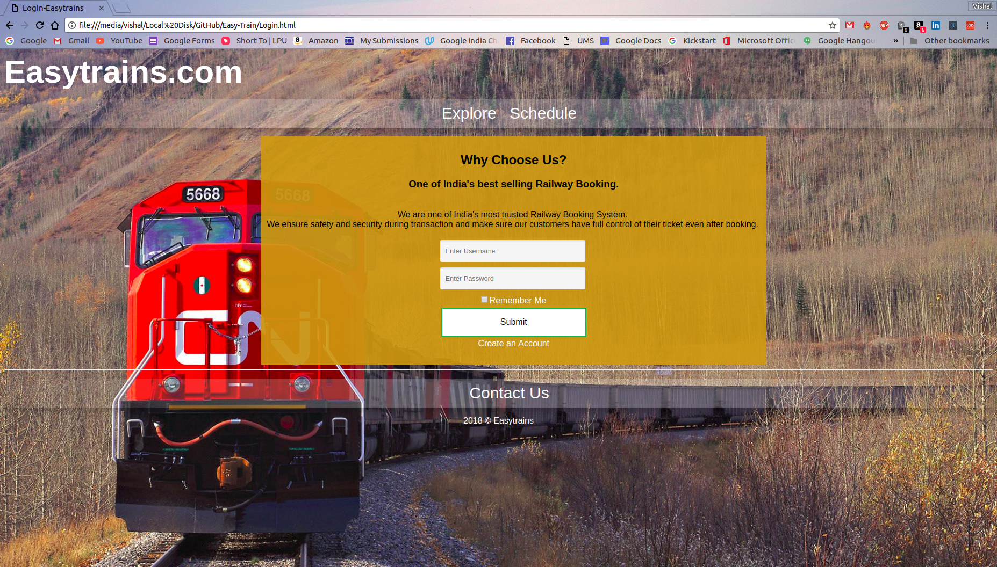
Login Page

Slide 6
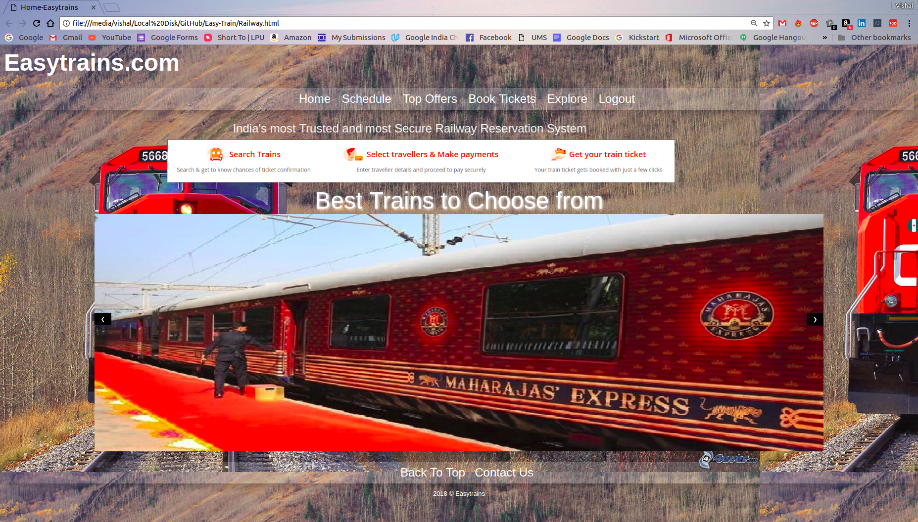
Home Page

Slide 7
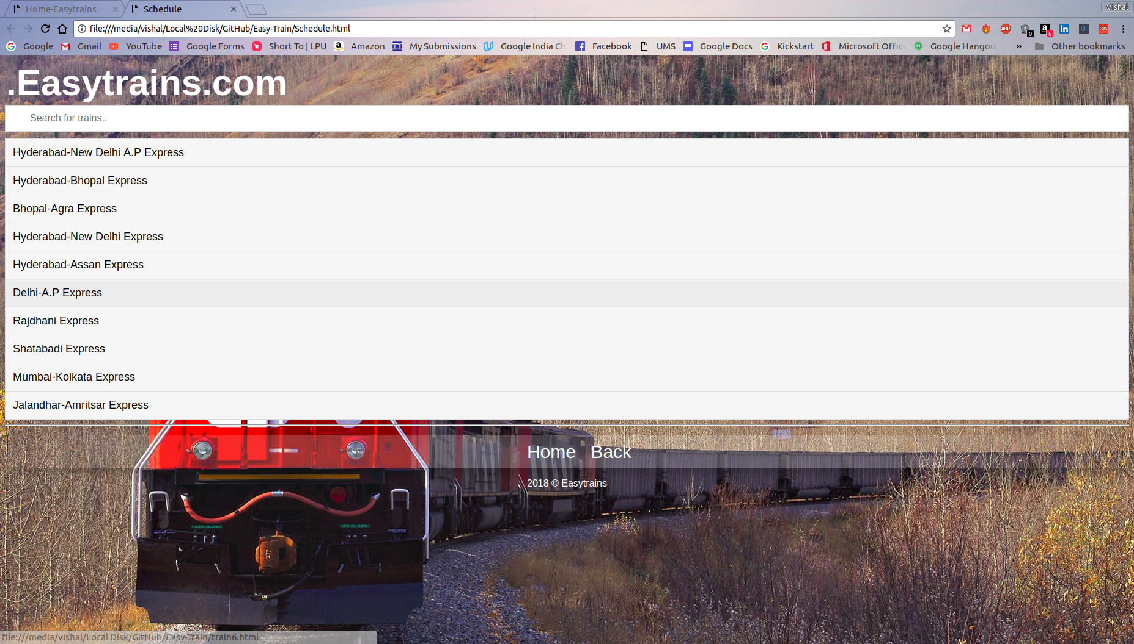
Schedule Page

Slide 8
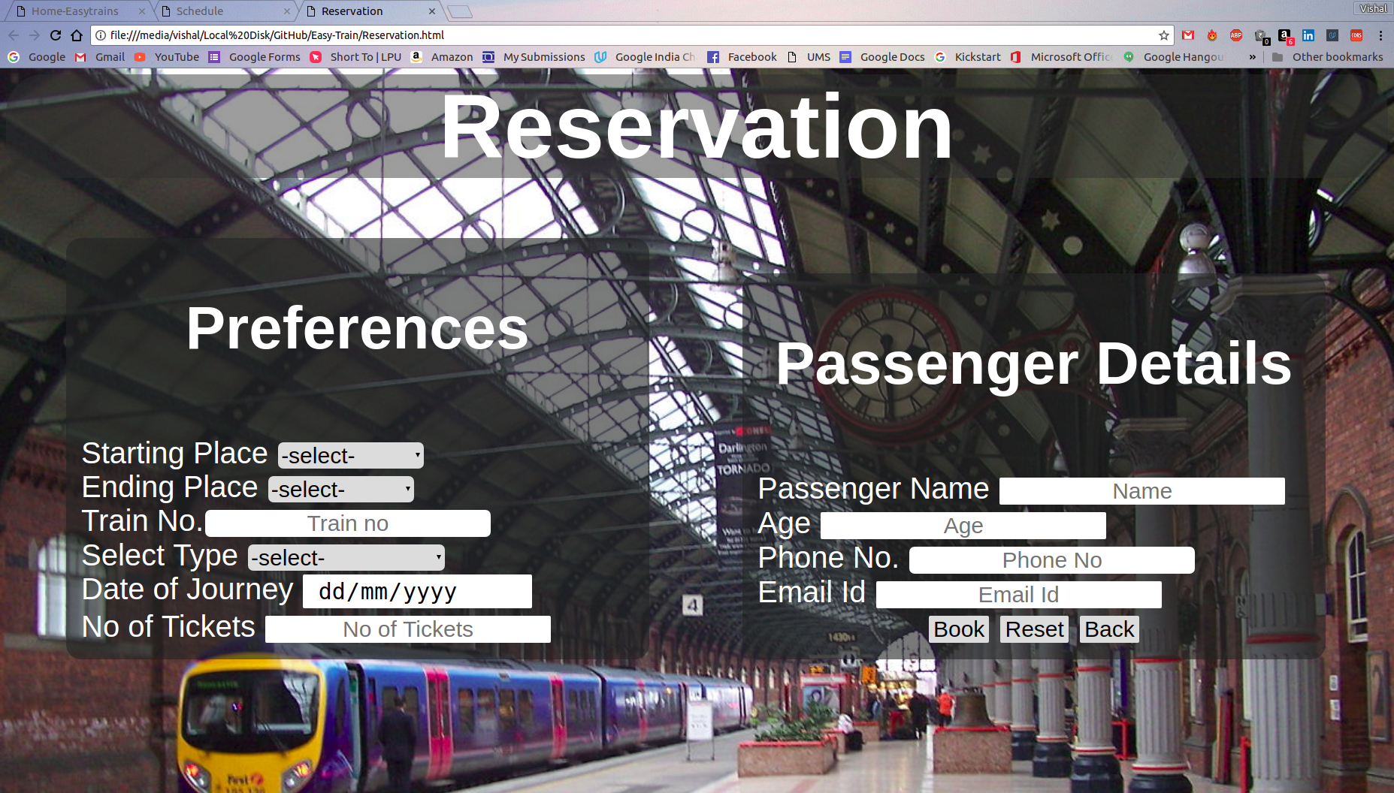
Reservation Page

Slide 9
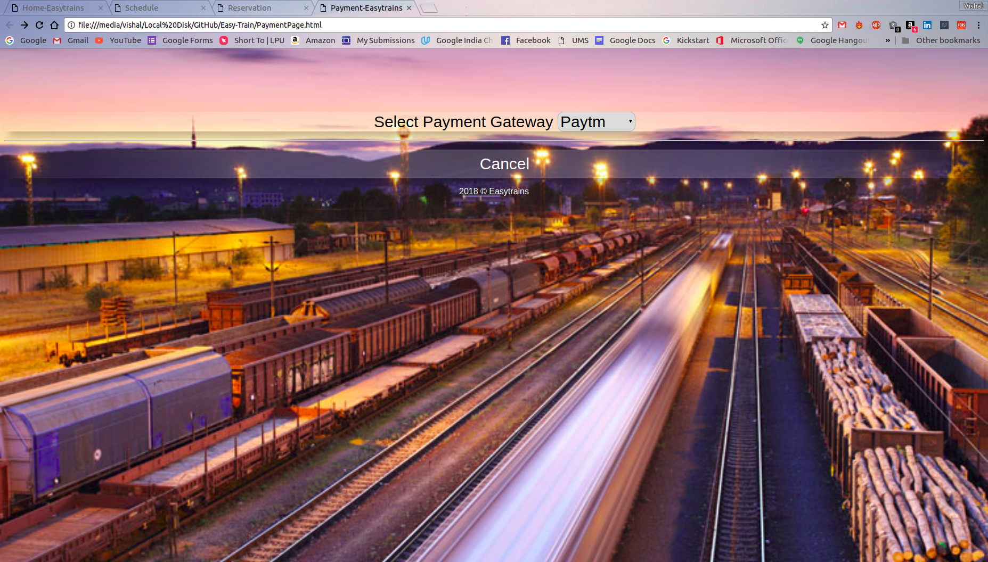
Payement Gateway

Slide 10
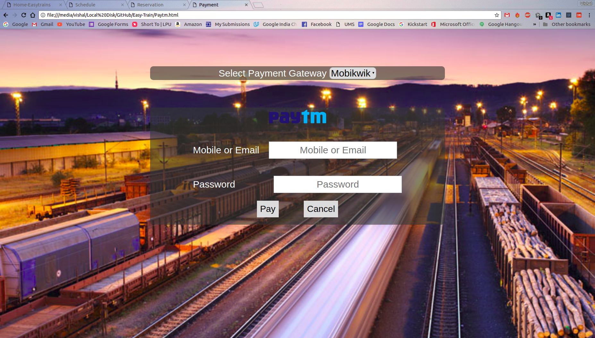
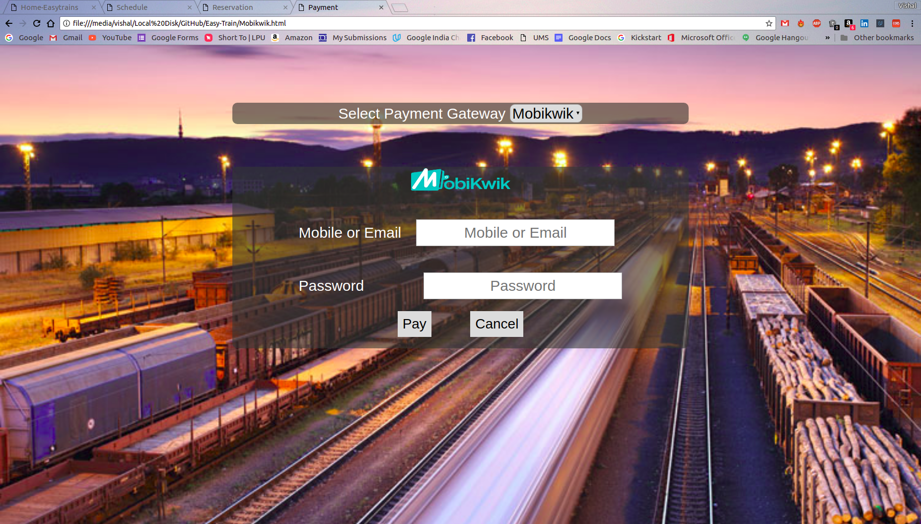
Payment Modes

Slide 11
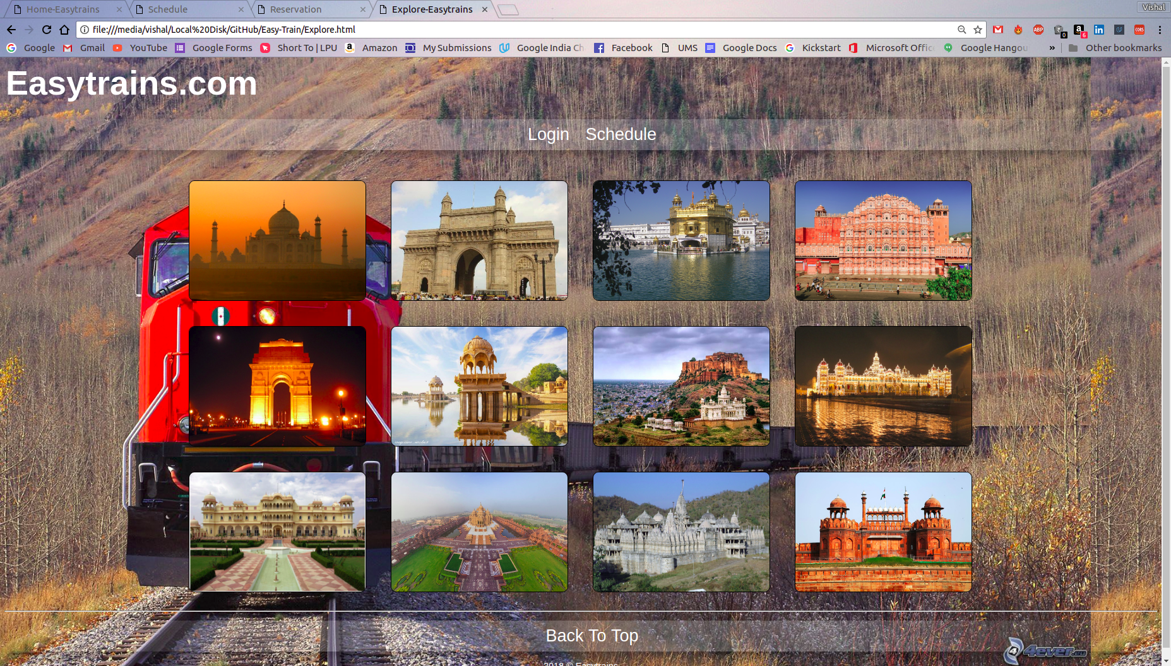
Explore Page

Slide 12
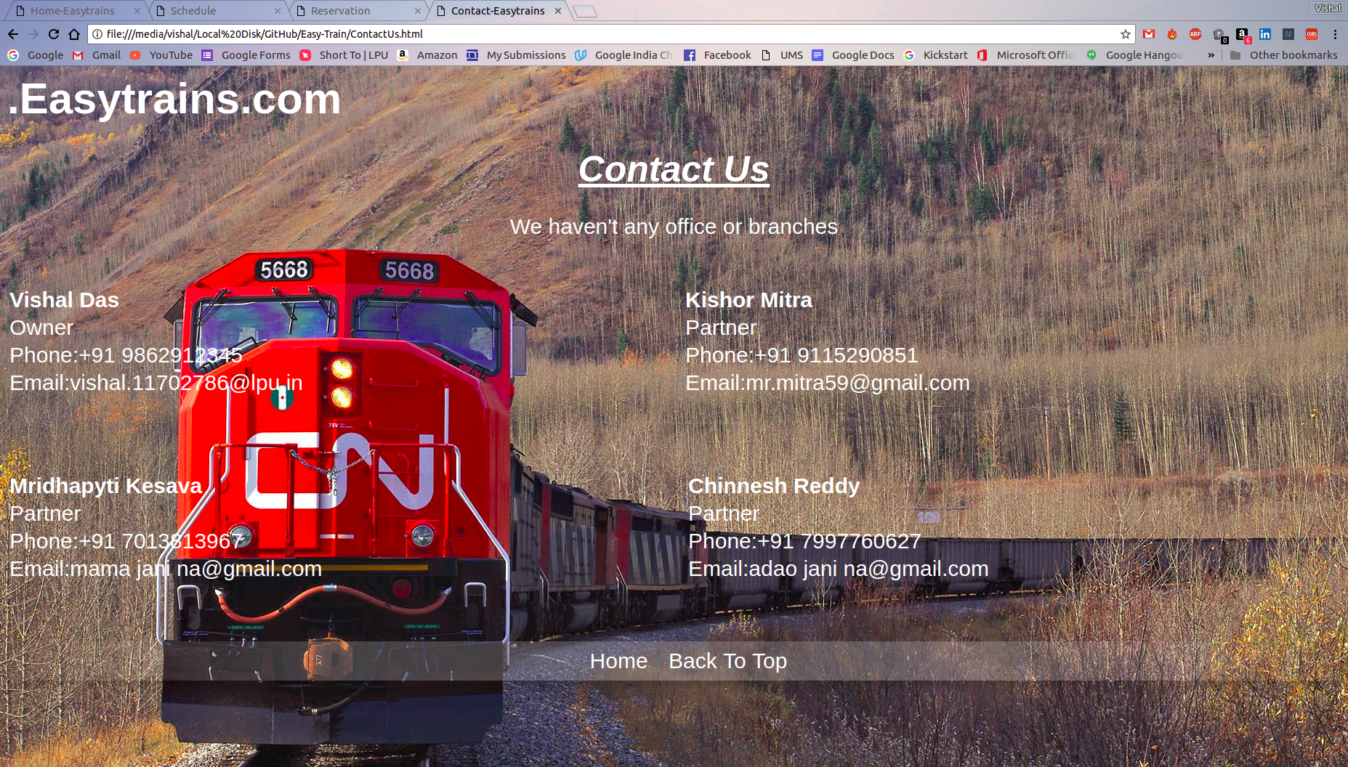
Contact Us

Slide 13
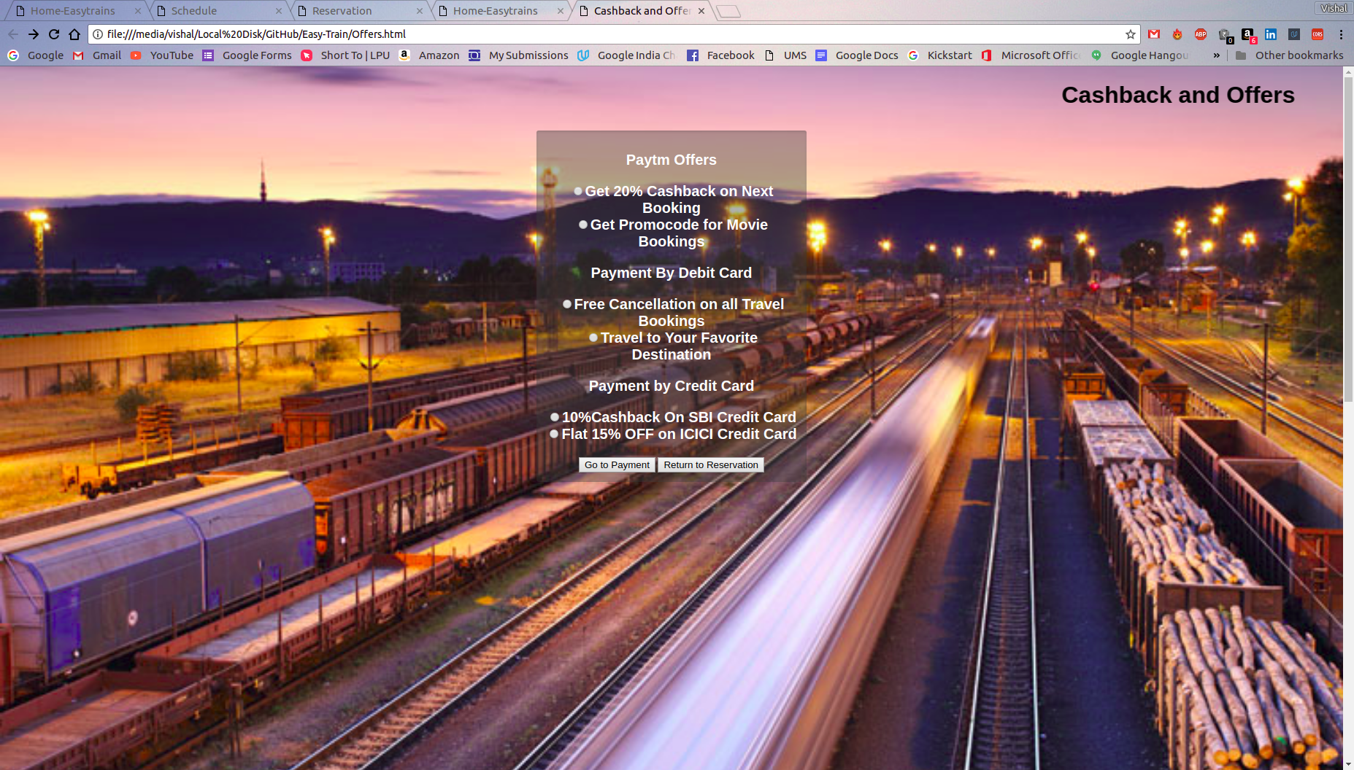
Offers Page

Slide 14
Resposible Person
Vishal Das: Login, Homepage, Signup and Explore
Kishor Mitra: Schedule and Contact Us
Keshav Mrithipati: Reservation and Offers
Chinnesh: Payment Gateway and Payment

Slide 15
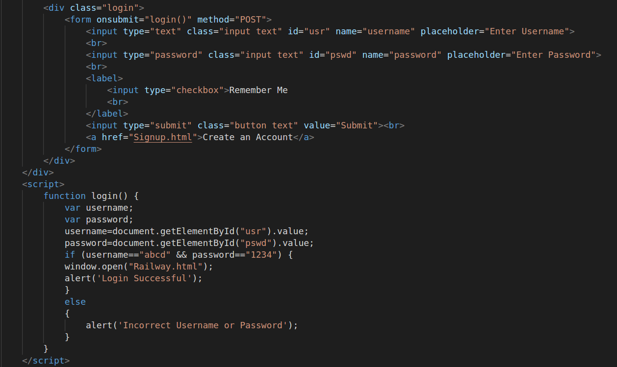
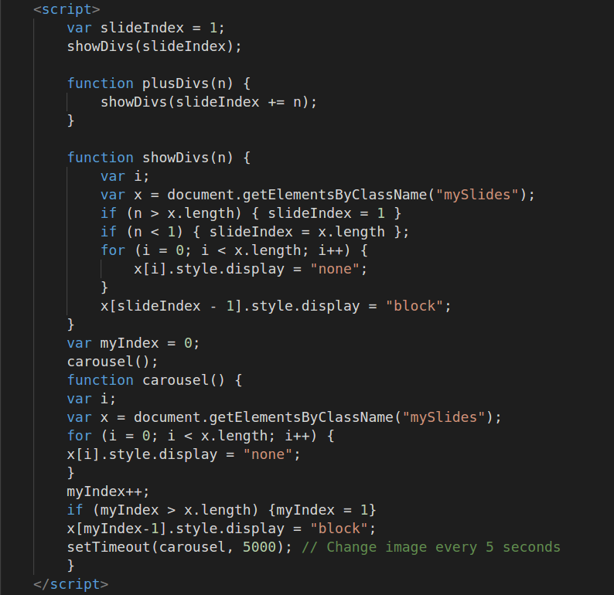
Vishal’s Screenshots and Code Snippets

Slide 16
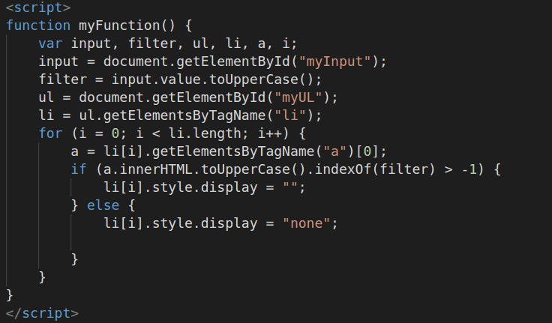
Kishor’s Screenshots and Code Snippets

Slide 17
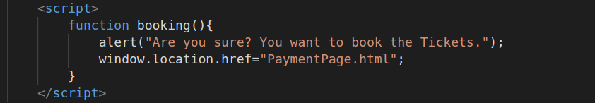
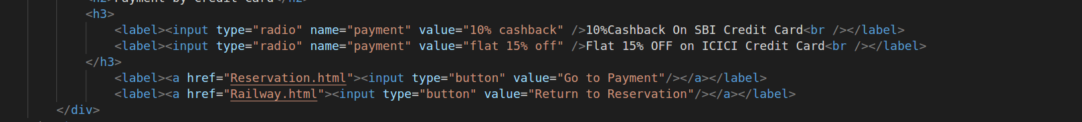
Keshav’s Screenshots and Code Snippets

Slide 18
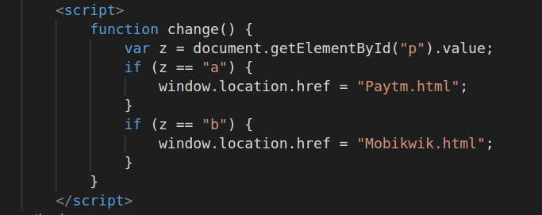
Chinesh’s Screenshots and Code Snippets

Slide 19
Summary
We have designed our project in such a way it provides an easy way of booking a ticket and made travelling through train easier.
Our project gives accurate information of train schedule and secure mode of payment.
We hope this project does some help towards the betterment of Railway Reservation in India although the Project requies more to be done, we will try our best to complete that in the future.

